Slide 1
How Do I Pay For It?
Notes:
UCanGo2 is an initiative designed to provide information about planning, preparing and paying for college.
Workbooks and flyers are provided to students and parents and can be downloaded directly from our college access website, UCanGo2.org.

Slide 2
What is ?
College access program for high school and middle school students and parents
Provides information on how to plan, prepare and pay for college
Helps families create a college-going culture in the home
Notes:
UCanGo2 is an initiative of the Oklahoma College Assistance Program (OCAP) and the Oklahoma State Regents for Higher Education.
UCanGo2 offers college planning information to students and parents.
The Publications link houses several documents and resources that offer valuable tools for anyone considering higher education.
The Scholarship section allows all students to search for scholarships by deadline and category.

Slide 3
Notes:
UCanGo2.org allows users to access the information specific to their needs.
Each section offers resources to middle and high school students, parents and counselors.
Most material can be located and downloaded from the Publications link.
Click on the StartWithFAFSA.org link to find valuable information about the Free Application for Federal Student Aid (FAFSA).

Slide 4
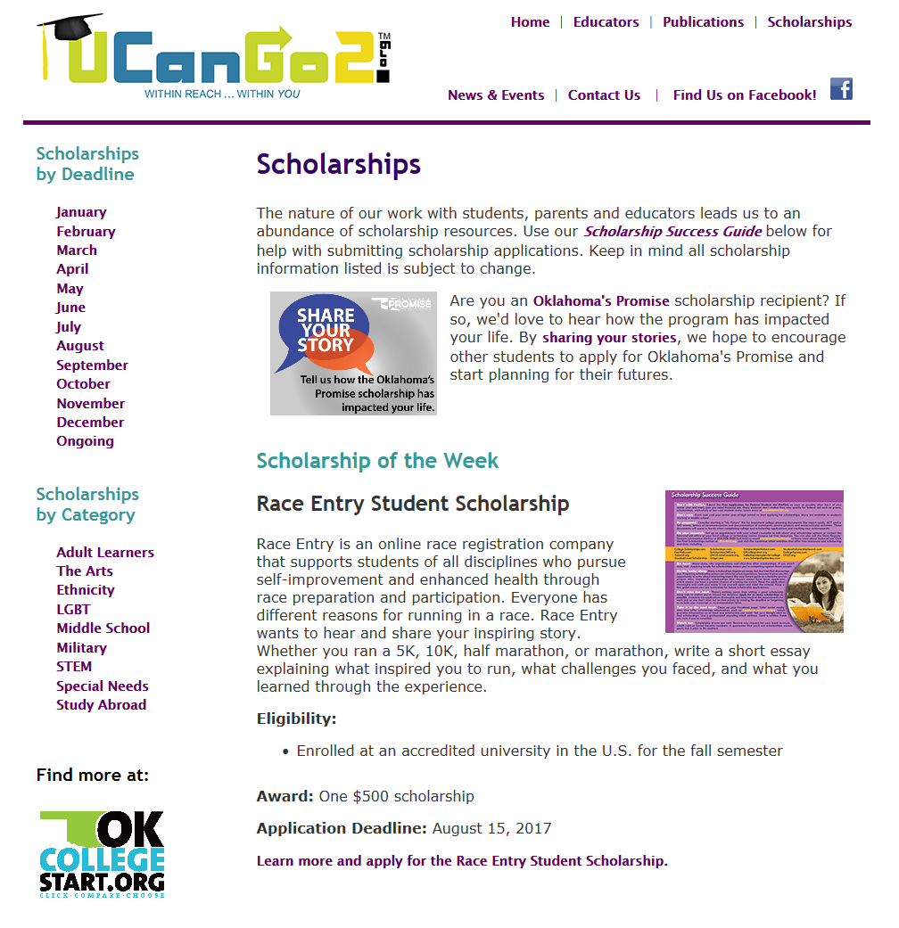
Notes:
In our Scholarship section students will see the Scholarship of the Week, as well as links to scholarships by deadline and category.
At the end of each month’s scholarship descriptions, students will find a list of other scholarships due that particular month.
Scholarships by Category offers several options for students of all ages and interests.

Slide 5
High School Student Workbook
Why Go to College?
What Do I Want to Be?
How Do I Get There?
Where Do I Go?
How Do I Pay For It?
Notes:
The UCanGo2 High School Student Workbook covers five main areas of college planning.
This PowerPoint covers the fifth section, ‘How Do I Pay for It?’
It speaks on the cost of college expenses here in Oklahoma.
Provides websites to connect you with scholarships for college.
Explains the different categories of financial aid available.
Describes the FAFSA (Free Application for Federal Student Aid) with tips for application.

Slide 6
What Is Financial Aid?
Money used to help you pay for college
Comes in the form of grants, scholarships, work programs and student loans
All students are eligible for some type of financial assistance for college
Seniors should apply for this money through the FAFSA after October 1, 2017
Notes:
Seniors and parents should apply for financial aid by completing the FAFSA (Free Application for Federal Student Aid) after October 1, 2017.

Slide 7
Getting Financial Aid
Set up your Federal Student Aid (FSA) ID
Complete the Free Application for Federal Student Aid (FAFSA) at FAFSA.gov
Use your FSA ID to sign your FAFSA
Never pay to complete the FAFSA: It’s FREE!
Notes:
Always use FAFSA.gov to apply for federal and some state financial aid.
Students and parents may set up their FSA ID before they complete the FAFSA.
The FSA ID is used to access the FAFSA, download IRS tax information, and sign the FAFSA application.
Create the FSA ID at FSAID.ed.gov.

Slide 8
Types of Financial Aid
Free Money
Grants
Scholarships
Earned Money
Work-Study
Student Loans
Subsidized
Unsubsidized
Parent Loans
Notes:
Visit UCanGo2.org to find descriptions of all financial aid programs or find additional resources at StudentAid.ed.gov.

Slide 9
Federal Grants
Money that does not have to be paid back
Usually awarded on the basis of financial need
Apply for all federal grants through the FAFSA
Types of grants
Pell Grant
Iraq and Afghanistan Service Grant
Teacher Education Assistance for College and Higher Education (TEACH) Grant
Federal Supplemental Educational Opportunity Grant (FSEOG)

Slide 10
Scholarships
Money that does not have to be paid back
Awarded on merit, financial need, skills, hobbies, family history and athletics
Apply for as many scholarships as possible
Check the Scholarship section at UCanGo2.org and Like us on Facebook for weekly scholarship listings
Search scholarship websites, books, local organizations, churches, family employers, college financial aid offices
Contact your tribal office for assistance
Notes:
UCanGo2.org offers a scholarship section that provides:
Scholarship of the Week
Monthly highlighted scholarships
A list of scholarships divided by deadline date and category

Slide 11
Are You Looking for Money?

Slide 12
Scholarship Resources
College
Prep Info
Notes:
‘Like’ UCanGo2 on Facebook to receive information on college planning, valuable educational articles and scholarships.
Watch for our blue dollar sign box each week for a list of scholarships for college.

Slide 13
College Work-Study
Provides part-time jobs for students with financial need
Jobs available on- or off-campus where you’ll perform duties related to a course of study or through involvement within the community
Types of jobs, pay rates and work schedules can vary greatly

Slide 14
Federal Student Loans
Students and parents may borrow money to pay for college
Loans must be repaid and repayment usually begins after education is complete or you withdraw from college
Only borrow what is really needed
Look at loans as an investment in your future

Slide 15
Loan Types
Federal Direct Loan
Subsidized: Government pays the interest while you’re in school
Unsubsidized: Student is responsible for the interest on this loan
PLUS Loan
Parent Loan for Undergraduate Students

Slide 16
Oklahoma Financial Aid
Oklahoma Tuition Aid Grant (OTAG)
Oklahoma resident
Apply with the FAFSA
Oklahoma’s Promise
Scholarship for eligible Oklahoma students
Apply in the 8th, 9th or 10th grade at okpromise.org
Academic Scholars Program
Awarded to students who score in the 99.5 percentile on the ACT/SAT exams

Slide 17
Financial Aid Resources

Slide 18
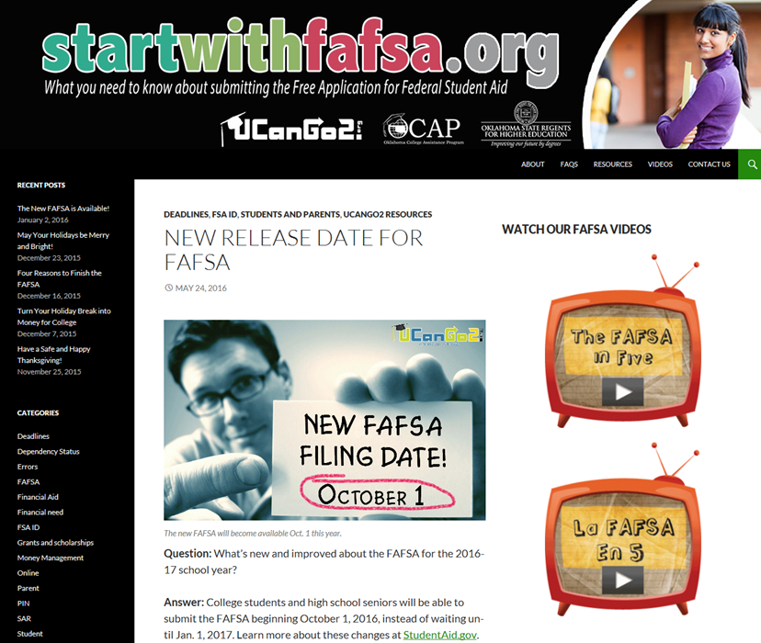
StartWithFAFSA.org
FAFSA blogs
Educational videos in English and Spanish
Information on financial aid, money management, income tax and FAFSA dependency status
Common errors
Frequently asked questions
Notes:
Find valuable information and resources on the FAFSA and financial aid at StartWithFAFSA.org.

Slide 19
UCanGo2.org
Search scholarships
Organize by deadline or by category
Scholarship Success Guide
Notes:
Visit the Scholarship section of UCanGo2.org to search thousands of scholarships.
Organize by application deadline or by category.

Slide 20
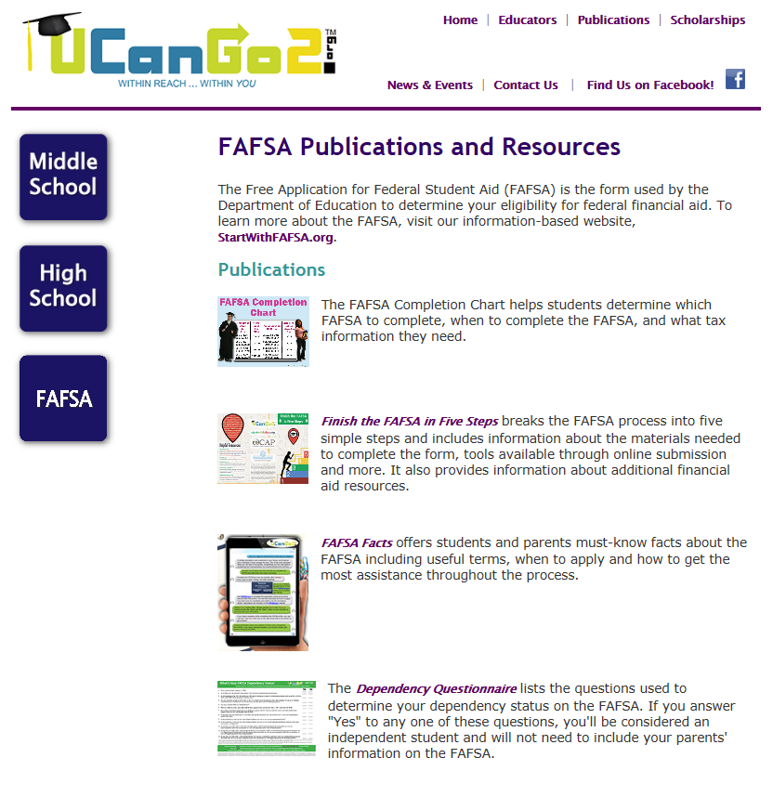
UCanGo2.org
Finish the FAFSA in Five Steps
FAFSA Facts
Dependency Status Questionnaire
Additional Resources
Notes:
Check out the FAFSA button on the Publications page to find links to the FAFSA application, FAFSA publications, financial aid information for Hispanic students and a link to Oklahoma’s Promise.

Slide 21
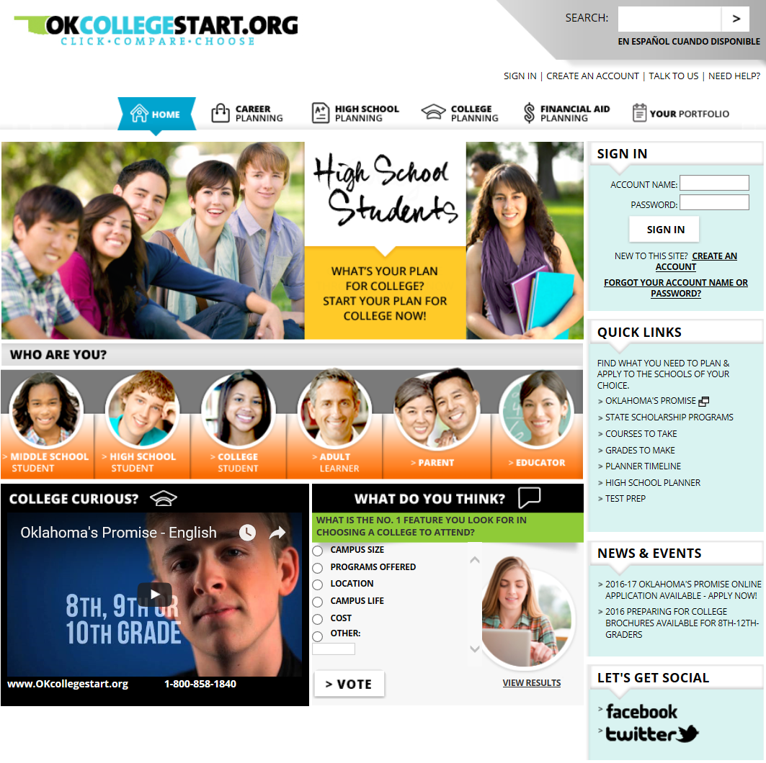
OKcollegestart.org
Search Scholarships
Explore Careers
Compare Schools
Research Financial Aid Options
Apply for Oklahoma’s Promise
Notes:
OKcollegestart.org is a one-stop-shop for middle school students, high school students, college students, adult learners, parents, and educators.
Students can explore careers, compare schools, learn about financial aid, and search for scholarships.
Students also submit applications for Oklahoma’s Promise through OKcollegestart.org.
Create a free account to access a wide variety of college and career planning tools.

Slide 22
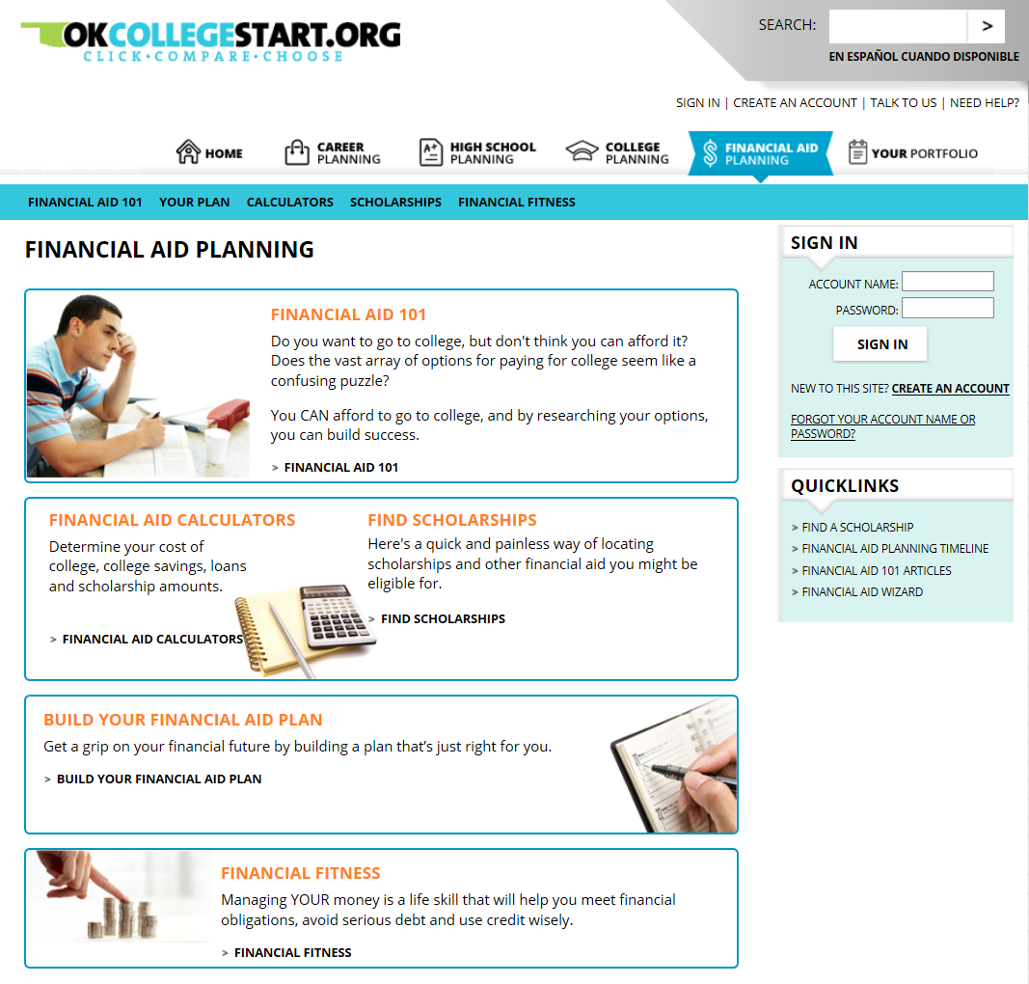
OKcollegestart.org
Financial Aid Planning
Financial Aid 101
Financial Aid Calculators
Scholarships
Financial Fitness
Notes:
Financial Aid 101 outlines financial aid basics, eligibility requirements, and important information you need to know.
Calculate your Expected Family Contribution (EFC), how much you should be saving for college, and determine the interest and monthly payments for student loans.

Slide 23
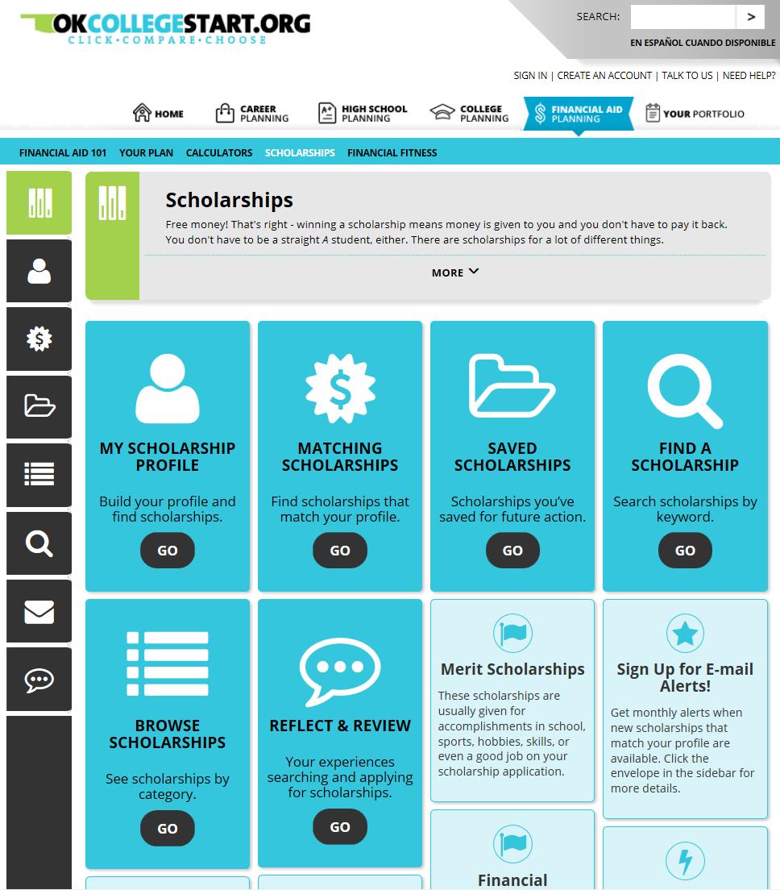
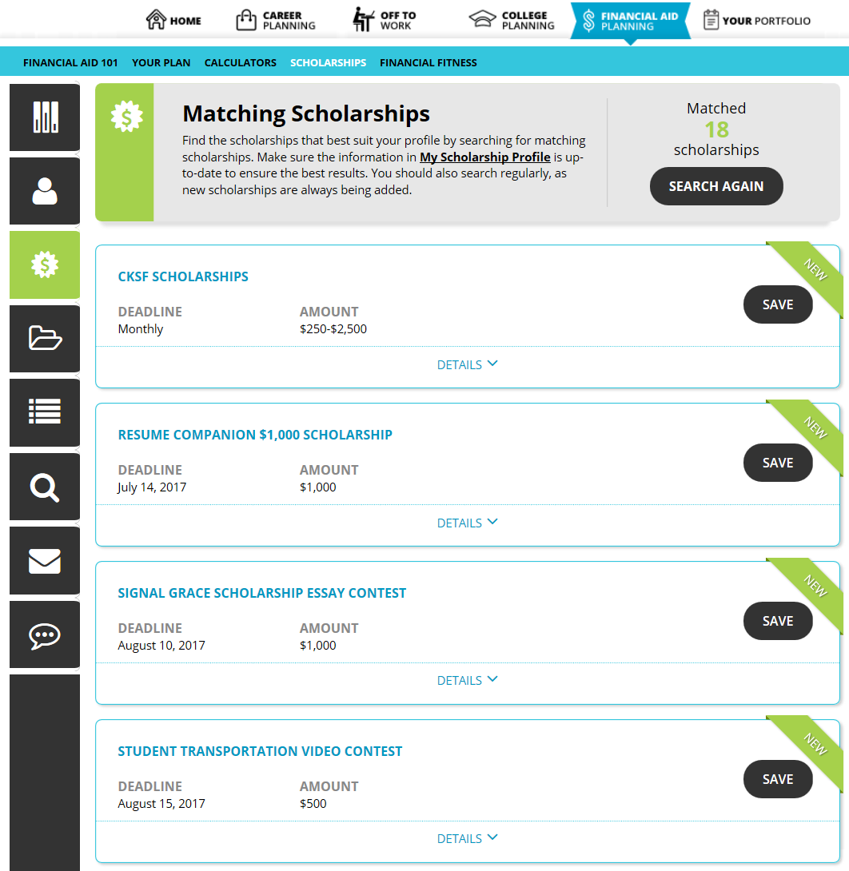
OKcollegestart.org
Find Scholarships
Create profile
Find matching scholarships
Save scholarships
Receive reminders
Notes:
Find a Scholarship allows students to search over 20,000 scholarships.
OKcollegestart allows you to save and track scholarships.
You can also receive deadline reminders for scholarships you’re interested in.

Slide 24
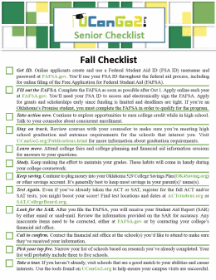
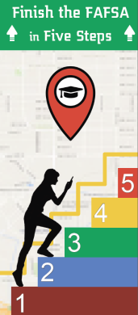
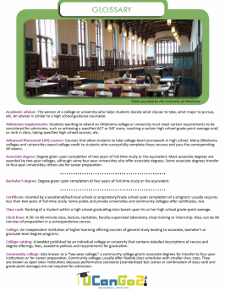
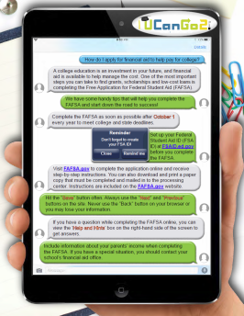
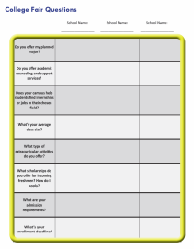
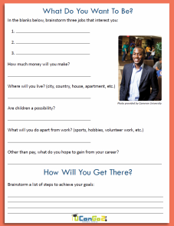
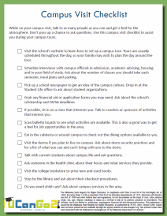
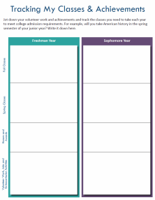
Helpful Publications
College Planning
Checklists
Finish the
FAFSA in
Five Steps
College
Terms
Glossary
Your Transition
to College
Brochure
Scholarship
Success Guide
FAFSA Facts
My Classes &
Achievements
Worksheet
High School
Student
Workbook
Are You
Looking
for Money?
What Do I
Want To Be?
Worksheet
Campus
Visit
Checklist
College Fair
Worksheet
Notes:
You’ll find all of these materials under the Publications link at UCanGo2.org.

Slide 25
Questions?

Slide 26
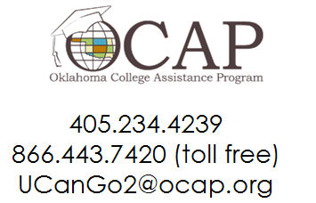
Contact Us
Oklahoma State Regents for Higher Education
Oklahoma College Assistance Program
Outreach Department

