Slide 1
How Do I Get There?
Notes:
UCanGo2 is an initiative designed to provide information about planning, preparing and paying for college.
Workbooks and flyers are provided to students and parents and can be downloaded directly from our college access website, UCanGo2.org.

Slide 2
What is ?
College access program for high school and middle school students and parents
Provides information on how to plan, prepare and pay for college
Helps families create a college-going culture in the home
Notes:
UCanGo2 is an initiative of the Oklahoma College Assistance Program (OCAP) and the Oklahoma State Regents for Higher Education.
UCanGo2 offers college planning information to students and parents.
The Publications link houses several documents and resources that offer valuable tools for anyone considering higher education.
The Scholarship section allows all students to search for scholarships by deadline and category.

Slide 3
Notes:
UCanGo2.org allows users to access the information specific to their needs.
Each section offers resources to middle and high school students, parents and counselors.
Most material can be located and downloaded from the Publications link.
Click on the StartWithFAFSA.org link to find valuable information about the Free Application for Federal Student Aid (FAFSA).

Slide 4
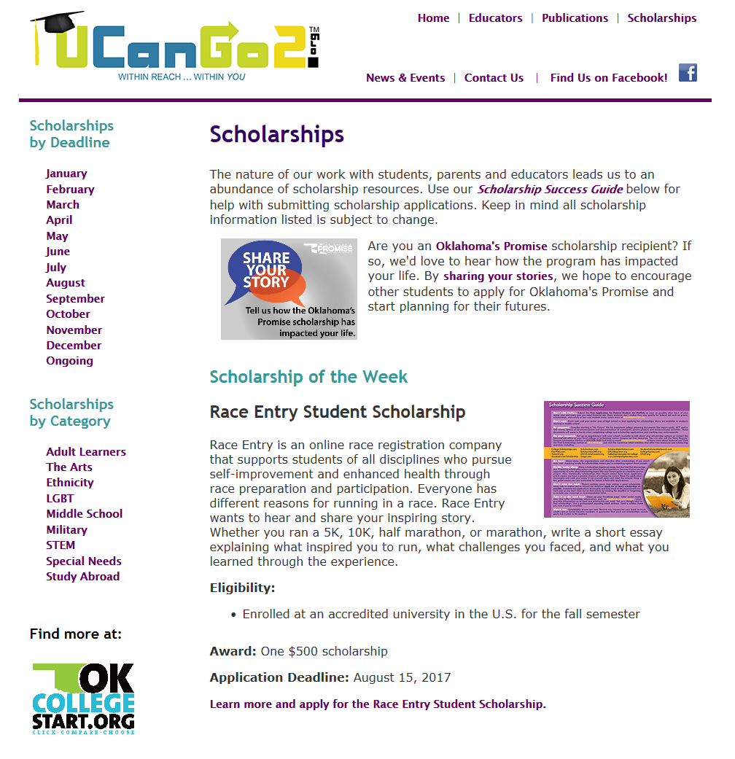
Notes:
In our Scholarship section students will see the Scholarship of the Week, as well as links to scholarships by deadline and category.
At the end of each month’s scholarship descriptions, students will find a list of other scholarships due that particular month.
Scholarships by Category offers several options for students of all ages and interests.

Slide 5
High School Student Workbook
Why Go to College?
What Do I Want to Be?
How Do I Get There?
Where Do I Go?
How Do I Pay For It?
Notes:
The UCanGo2 High School Student Workbook covers five main areas of college planning.
This PowerPoint covers the third section, ‘How Do I Get There?’
It outlines ways for you to be successful in high school to ensure your admission to college.

Slide 6
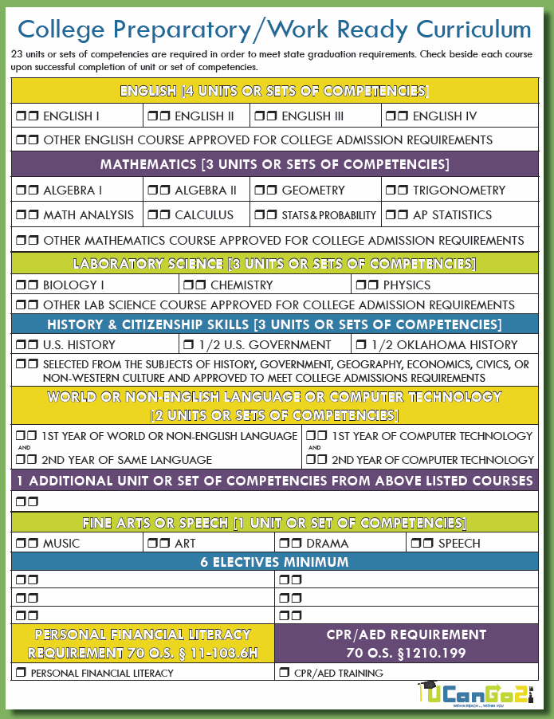
Take the Right Classes
The College Preparatory/Work Ready Curriculum graduation requirements are in
alignment with the admissions requirements at Oklahoma’s colleges and universities and with the Oklahoma’s Promise curriculum.
Notes:
If you plan to attend a public college or university in Oklahoma, you need to take certain courses during high school.

Slide 7
Strengthen Study Habits
Good grades are important!
Develop great study skills now so you can excel
in high school and in college. Try these tips:
Study in a quiet area and take breaks
Write down assignments and due dates
Check, edit and proofread your homework
Organize your desk and papers
Listen carefully in class and ask questions
Study your most challenging subject first
Notes:
The entire The Perfect 10 Study Habits Guide can be found in the UCanGo2 High School Student Workbook.

Slide 8
ACT / SAT Tests
ACT and SAT tests are used to measure your educational achievement in a variety of subjects
Your score may be used to help you meet admission standards at certain colleges
Tests usually cost between $30 - $50, but fee waivers are available
Take free practices tests at OKcollegestart.org
Visit these sites to find test dates:
ACT.org
SAT. org
Notes:
All students should take advantage of the free ACT and SAT practice tests at OKcollegestart.org.
The UCanGo2 Facebook page provides you with test dates and encourages you to sign up to avoid certain late fees.

Slide 9
Earn College Credit Now
Advanced Placement (AP) Courses
Take college-level coursework in high school
Concurrent Enrollment
Allows juniors and seniors to take credit-earning college courses in high school
Notes:
Ask your high school counselor about all of these options.

Slide 10
Oklahoma’s Promise
Must be an Oklahoma resident
Apply in 8th, 9th or 10th grade
Family income must be $55,000 or less at the time of application
Receive free tuition at Oklahoma public two-year colleges and four-year universities
Receive a portion of tuition at private colleges and approved career technology centers
Visit okpromise.org or call 800.858.1840 for more information
Notes:
Oklahoma’s Promise students must complete a FAFSA every year they’re in college.

Slide 11
Go the Extra Mile
Extracurricular activities
Volunteer work
Community service
Photo courtesy of Northeastern State University
Notes:
Several scholarships ask you to provide your volunteer work as part of the criteria.
Many college admission applications are also asking if you’ve done any community service or volunteer work in your hometown.

Slide 12
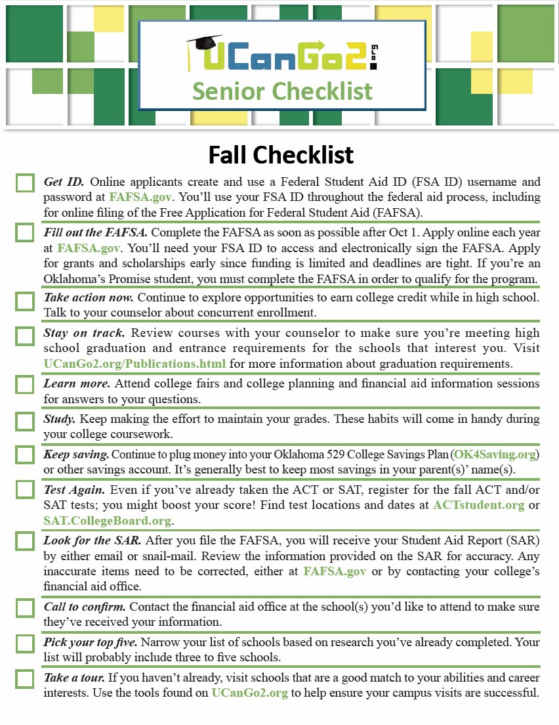
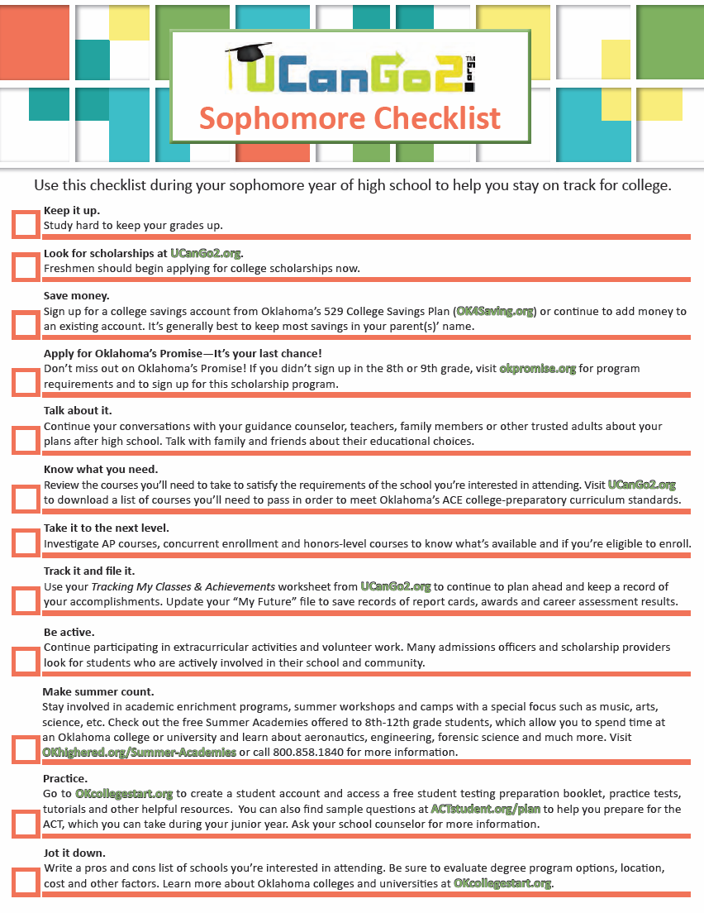
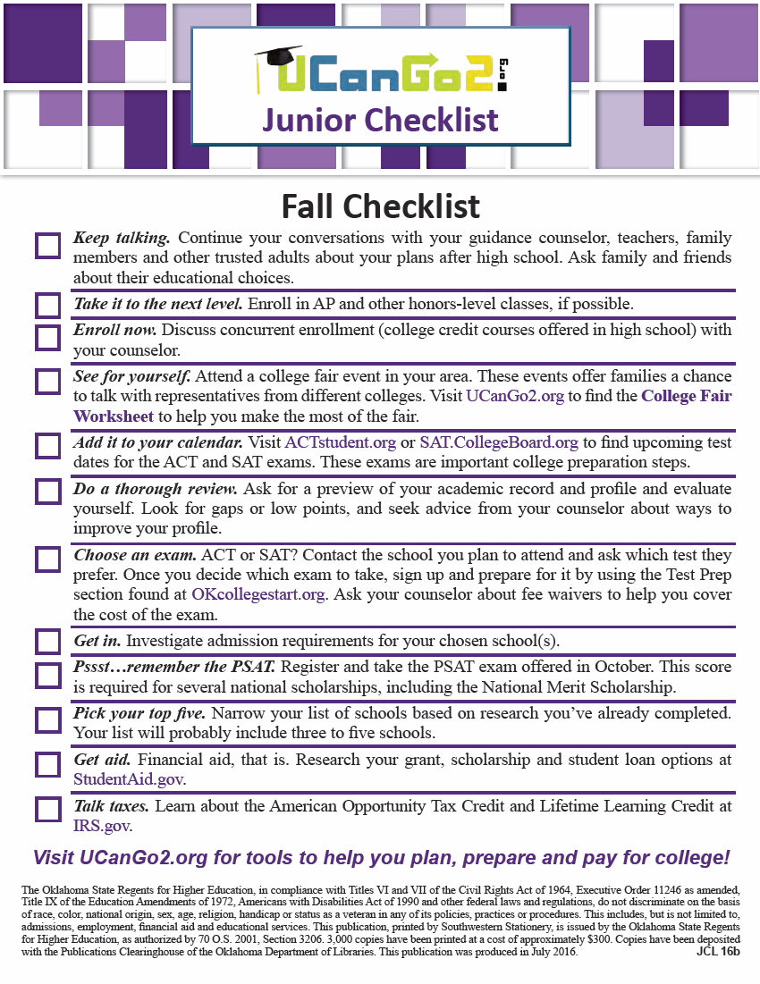
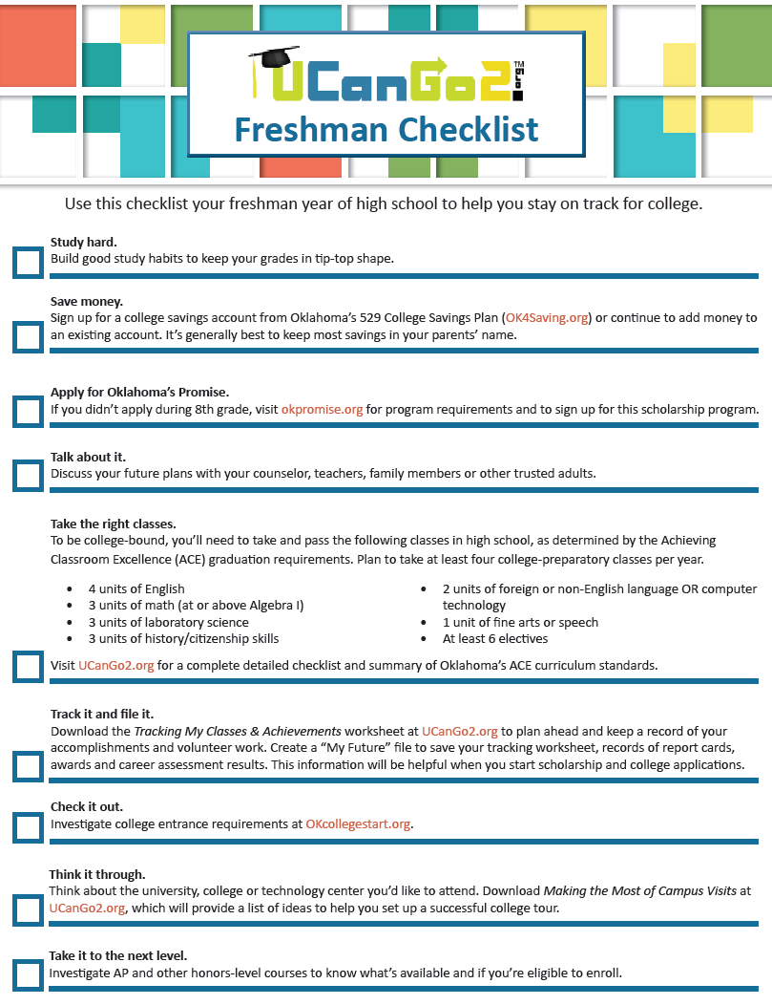
High School Checklists
Notes:
These checklists provide helpful tips to assist you in planning for college during each year of high school.
These can be found at UCanGo2.org.

Slide 13
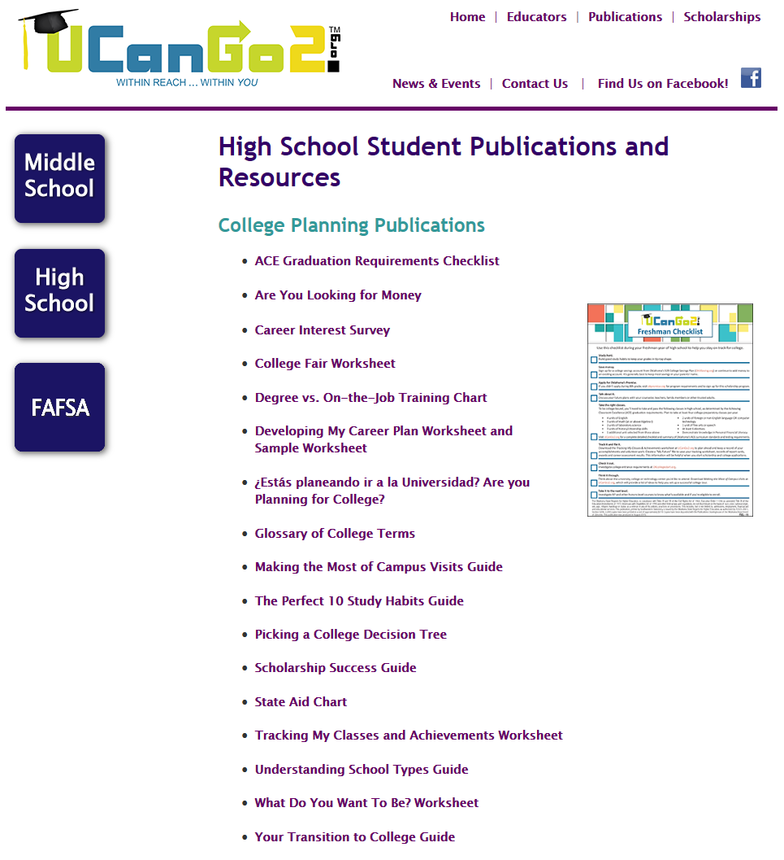
Notes:
This section highlights the ‘Tracking My Classes and Achievements Worksheet.’
Use this form to keep track of the classes you’ve taken in high school.
Keep a list of all your extracurricular activities, awards, honors and volunteer work.
A full list of your accomplishments in high school will be a great tool when you complete scholarship applications or ask for letters of recommendation from adults.

Slide 14
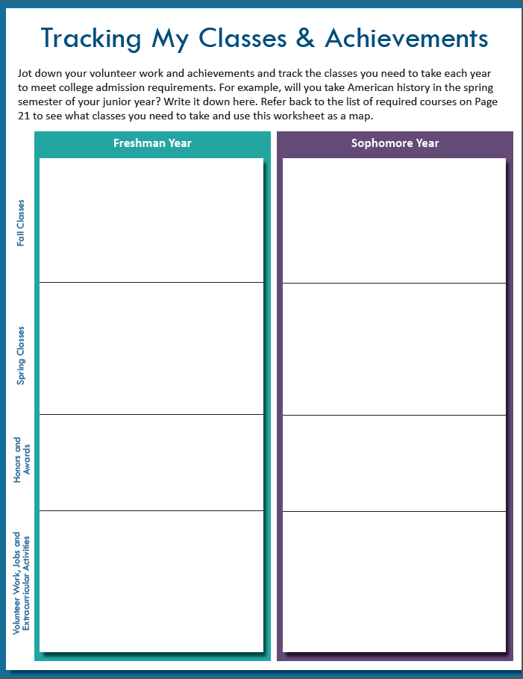
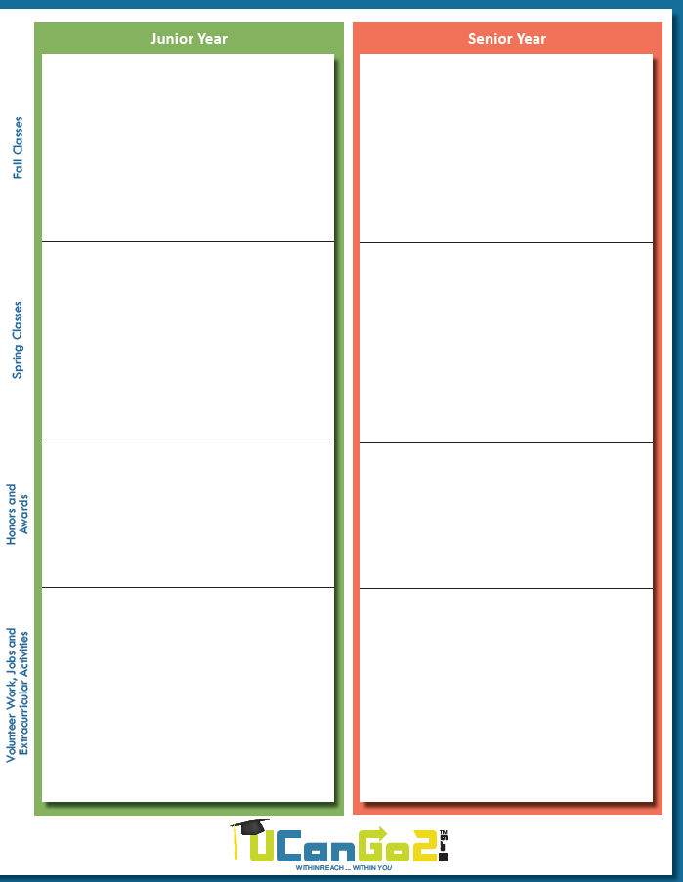
Notes:
Track your awards, classes, jobs, volunteer work.

Slide 15
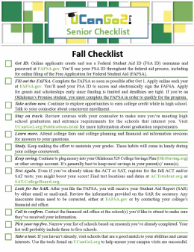
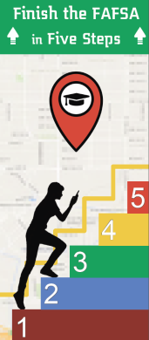
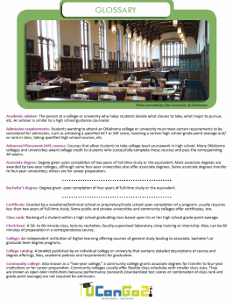
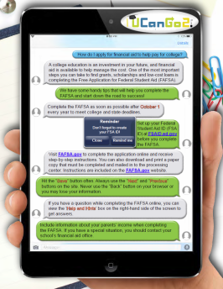
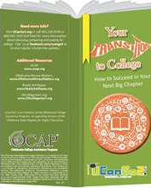
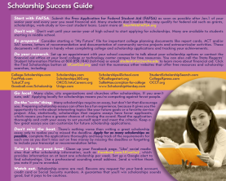
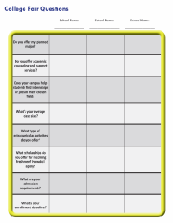
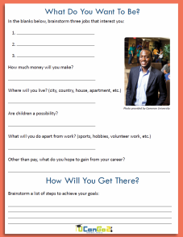
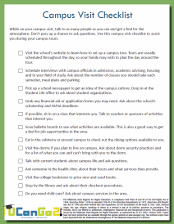
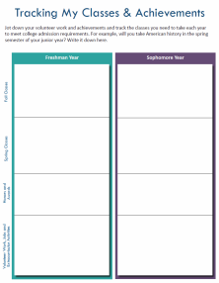
Helpful Publications
College Planning
Checklists
Finish the
FAFSA in
Five Steps
College
Terms
Glossary
Your Transition
to College
Brochure
Scholarship
Success Guide
FAFSA Facts
My Classes &
Achievements
Worksheet
High School
Student
Workbook
Are You
Looking
for Money?
What Do I
Want To Be?
Worksheet
Campus
Visit
Checklist
College Fair
Worksheet
Notes:
You’ll find all of these materials under the Publications link at UCanGo2.org.

Slide 16
Questions?

Slide 17
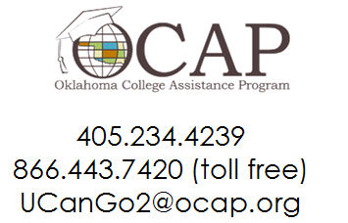
Contact Us
Oklahoma State Regents for Higher Education
Oklahoma College Assistance Program
Outreach Department

